Slide 1
Aero Valley Property Owners Association
Annual Meeting
November 10, 2022

Slide 2
Welcome
AVPOA Board Members
Eric Branyan, President
Bob Smith, Vice President
Larry Martin, Treasurer
Mike Love, Secretary
Carey Sharp, Member
Mike Welch, Member
Scott Miller, Member
AVPOA Airport Manager
Rob Reece

Slide 3
Call To Order
Quorum in Attendance
  20% Required (43/216 current owners)
Meeting Roles
  Sergeant at Arms - Carey Sharp
  Timekeeper - Rob Reece
  Parliamentarian – Bob Smith

Slide 4
Code of Conduct
Introduce yourself before speaking
Open and respectful discussion
No more than three minutes per question
Voting will be in person or by proxy
Silence cell phones
No sidebar discussions
Robert’s Rules apply - no speaking until given the floor
Wait for Microphone when recognized so all can hear your remarks

Slide 5
Agenda
Approve 2021 Annual Meeting Minutes
2022 Priorities
Legal Update
Financial Report
  Approve 2023 Budget
Brief Updates
  Collections
  Safety Zone
  Repairs and Improvements
  Cleveland – Gibbs Realignment
  Potential AFW Class D change
Ratify Board Actions
Discussion Topics
  Amend By-Laws for Voting Privileges
  Fencing Standards
  Runway Markings
Elect Three Board Members
2023 Priority Review
Questions/Comments
Adjourn

Slide 6
Approve Minutes of 2021 Annual Meeting

Slide 7
Association Priorities
2022 Priorities
  Safe Operations
  Complete Litigation
  Financial Health
  Repairs and Upgrades

Slide 8
Legal Update
Declaratory Action Filed Aug 2020
  Temporary Injunction Granted Dec 2020
  Injunction Modified by Appeal Jan 2021
Motion for Summary Judgement (MSJ) Filed August 15, 2022
  Conclusion; Paragraph 76; Page 35; Requests Declarative Judgement on the following:
  the POA’s Board has the exclusive authority to govern, operate, and manage Aero Valley Airport
  the Board’s authority extends to all runway access and use easement holders
  AVDCO’s restrictions apply to all lots formerly owned by Whyte
  any document recorded by defendants is void to the extent that it conflicts with the POA’s authority to operate and manage the airport or conflicts with easement holders’ rights and duties
  defendants have a legal duty to transfer fee simple title to the runway-parallel taxiway tracts and other Airport common areas they own to the POA
Cross Motion for Summary Judgement (CSMJ) Filed by Defendant August 26, 2022
  Plaintiff Response to CMSJ Filed September 9, 2022
Hearing Held October 14, 2022
  No Judgment until other trial docket cleared through November
Half Day Hearing Scheduled November 22, 2022
  Outcome Determines Need/Content of Trial

Slide 9
Financials

Slide 10
Financials-Budget
Delinquent Collections = $488,602
  86 Owners
  Top 10 Equal 2 years of Normal Operations
  Remainder ~ 1 year of Normal Operations

Slide 11
Brief Updates
Collections
  11 Petitions filed August 2021
  Transitioned to Henry, Oddo, Austin & Fletcher, PC – April 2022
    Vinay Patel, ESQ – Specialist in Owner Association Management and Collection
  Current Status
    One Settled
    One Default Judgement- August 18, 2022
      Awarded Delinquent Assessment, Costs and Legal Fees
      Effort Continues to Recover the Award
    9 Deferred Until Feb 2023

Slide 12
Brief Updates
Safety Zone
  Safety Buffer from Runway to East Side buildings
  85 feet wide
    Transient Parking, No More Than 24 Hours Within 25 feet of Building Line
    No Permanent Parking of RVs, Trailers, Unmovable Items, Vehicles, Aircraft
  Filed by AVDCO April 16, 1982
    Denton County Records 1137/932
    In Deeds of Eastern Properties Along the Taxiway
    Permanent Unless Airport is No Longer Active
Please Keep It Clear!

Slide 13
Brief Updates
Repairs
  Accomplished-Thank You Volunteers!
    Douglas Drive Road Repair ($5,000 vs. $40,000 bid)
    Pot Hole Filling
    North End Tree Removal
  Future
    Seal Coat Runway
    South End Tree Removal
    Runway Drainage Improvements

Slide 14
Cleveland-Gibbs Re-Alignment
Plans Developed
Land Acquired via Eminent Domain Process During 2022
Inflation Impacted Planned Budget, Delayed for 2023 Budget Cycle

Slide 15
Potential AFW Class D Change
Meeting Mid August at AFW
  Annual Runway Safety Action Team (RSAT)
    Proposed to Discuss Runway Incursions
    Operations within the Airport Operations Area (AOA)
  Discussed Potential Expansion of Class D Airspace
    Encompass Hicks, Propwash, Northwest Regional
Would be a Significant Impact to Operations at 52F
Need a Volunteer for the AOPA Airport Support Network (ASN)
  Member of the AVPOA
  Member of AOPA
  Cannot be a member of the board
ASN Meeting at AFW 11/18

Slide 16
Ratification
RESOLVED, that all proceedings of the Board of Directors and all operations and actions taken by members of the Board of Directors and officers of this Association are approved and ratified as being actions taken by this Association, on behalf of this Association, and for the benefit of this Association.

Slide 17
Voting Privileges
Current Bylaws of the Association Allow All Members to Vote Regardless of Status of the Association Fee Assessments
The Bylaws Would Need to be Changed to Afford Voting Privileges to Only to Those Current in Their Association Fee Assessments
Association Bylaws Governing Voting
  Article III-Meeting Of Members
  Section 5. Voting
    “A member may vote at such meeting in person, electronically or by proxy. Every member shall be entitled to one vote regardless of the number of lots a member owns. All Association action shall be determined by majority vote, except as may be provided by law.”
  Section 5. Voting – Recommended Amendment
    “A member in good standing may vote at such meeting in person, electronically or by proxy. Good standing as defined by being current in Association Fee Assessments. Every member in good standing shall be entitled to one vote regardless of the number of lots a member owns. All Association action shall be determined by majority vote, except as may be provided by law.”

Slide 18
Fence Standard Establishment
Establish Fence Consistency
Get Approvals
  AVPOA, County, 811
POA Standard
No Fence on Empty Lots, Must be Associated with a Hanger, Home or Hanger-Home
The Fence Must Not Obstruct Any Taxiway.
No Chain Link or See-Through Fences.
The Fence Must be 6 or 8 Feet Tall.
The Fence Metal must Match the Hangar Metal and be the Same Color.
The Fence must be Edged/Trimmed on Top and Corners, the Trim can be the same Color as the Hangar Trim or the Fence Color.
Fence Posts must be on the Inward Side.
Wood Fences are Allowed only in Aero Valley Estates.
Gates can Open Inward or Outward.
Maintain the Fence
Existing Non-Conforming Fencing Must be Replaced When a Property is Sold

Slide 19
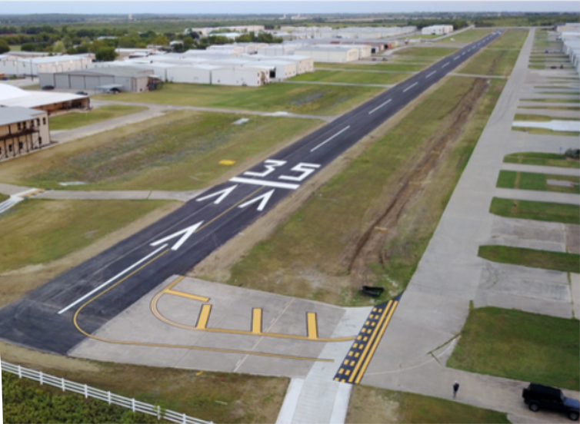
Runway Marking
FAA Conforming Marking added during 2016 Reconstruction
Complaints Received Hold Short Line Congestion
  Exacerbated by the Increase in Student Traffic
  Some Relief by Flight School Work Arounds
No Requirement for Private/Public Use Airports to Comply with FAA Rqmts
Revert to pre-2016 Markings
  Hold Line at Runway Edge
  Removal of Narrow Taxi Lane Markings
Marking Change May Increase Risks and Liabilities

Slide 20
Elections
Two Year Terms
Qualifications
  Time available
  Commitment to actively participate
  Four directors must be active pilots
  Business experience useful
  Proficient with MS Office and Adobe
  Self starter
  Team player

Slide 21
Elections
2023 Announced Candidates
  Eric Branyan, Incumbent
  Larry Martin, Incumbent
  Mike Love, Incumbent
2022 Board of Directors
Expiring Terms
  Eric Branyan, President
  Larry Martin, CPA, Treasurer
  Mike Love, Secretary
One Year Remaining
  Bob Smith, Vice President
  Carey Sharp
  Mike Welch
  Scott Miller
VOTE

Slide 22
Association Priorities
2023 Recommended Priorities
  Safe Operations
  Complete Litigation
  Financial Health
  Repairs and Upgrades

Slide 23
Questions/Comments?

Slide 24
Move to Adjourn
Thank You for Your Participation and Attendance!

